Slide 1

BUFFER OVERFLOW
Presented By: Brooj Nasir

Slide 2
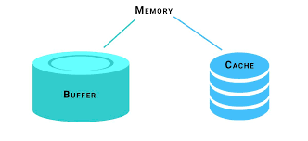

Buffer
Buffer is a region of memory which is used to store data temporarily while moving it from one place to another
Overflow
To have the contents flowing or spilling.

Slide 3
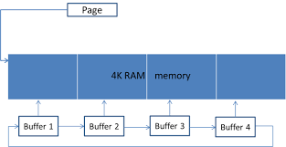

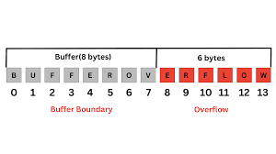
How is it an attack? How it arises?
Sending more data than the buffer can handle
Objective
Achieved
Target Buffers

Slide 4

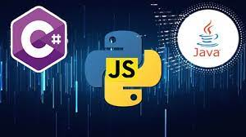
Who is Vulnerable to Buffer Overflow Attacks?
C and C++ are two languages with high vulnerability ,since they contain no built-in protections against accessing or overwriting data in their memory, Windows ,Mac OS and Linux all contain code written in one or both of these languages.
Languages like Java, Python, C# have built-in features that help reduce the chances of buffer overflow.

Slide 5

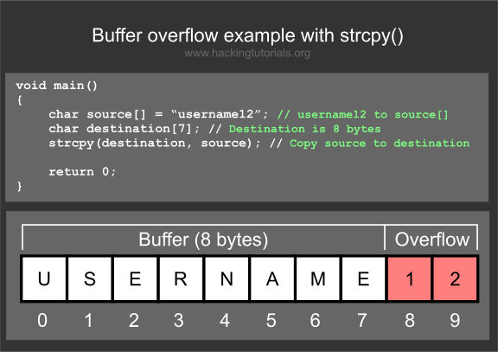
Example:

